Slide 1
Surface Plasmon Polaritons – Light confined to 2D
Why confine light to 2D?
What are SPPs?
What can support SPPs?
How can you excite SPPs?
Neat things you can do with SPPs

Slide 2
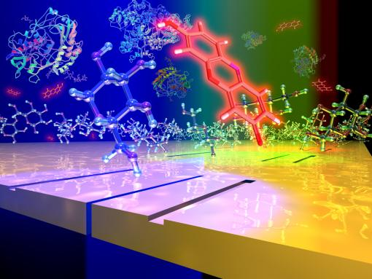
Why confine light?
Integrated Optical Circuits for computing
IEEE Photonics Journal ( Volume: 5, Issue: 4, Aug. 2013 )
SERS with SPPs
SPP-enhanced photochemistry
Siu et al, Nanophotonics, 3 125 (2014)
J. Phys. Chem. C, 2015, 119 (17), pp 9506–9512

Slide 3

What is an SPP?
Surface Plasmon Polariton: Light guided along a metal surface

Slide 4
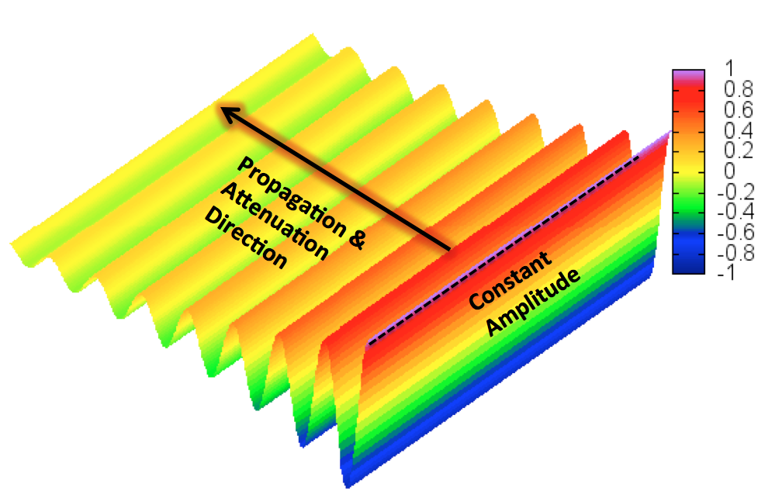
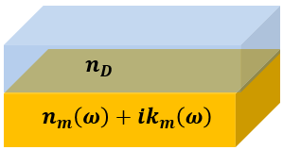
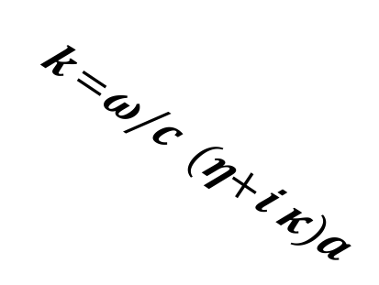
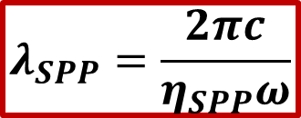
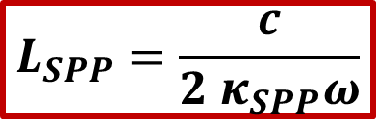
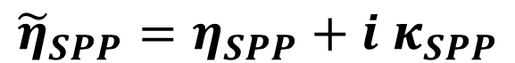
Light confined to Two Dimensions
SPPs propagation and attenuation related to effective indices
$$λ_{SPP}=\frac{2πc}{η_{SPP}ω}$$
$$L_{SPP}=\frac{c}{{2 κ}_{SPP}ω}$$
$${\tilde{η}}_{SPP}=η_{SPP}+i κ_{SPP}$$

Slide 5

Light confined to Two Dimensions
SPPs propagation and attenuation related to effective indices
$$λ_{SPP}=\frac{2πc}{η_{SPP}ω}$$
$$L_{SPP}=\frac{c}{{2 κ}_{SPP}ω}$$
$${\tilde{η}}_{SPP}≈\left(\frac{ω}{c}\right)\sqrt{\frac{{ε_{D}⋅ε}_{m}(ω)}{ε_{D}+ε_{m}\left(ω\right)}}$$

Slide 6
Predicted ~1957 by Rufus Ritchie Proposed that SPPs could be excited by firing energetic electrons at thin metal films

Slide 7
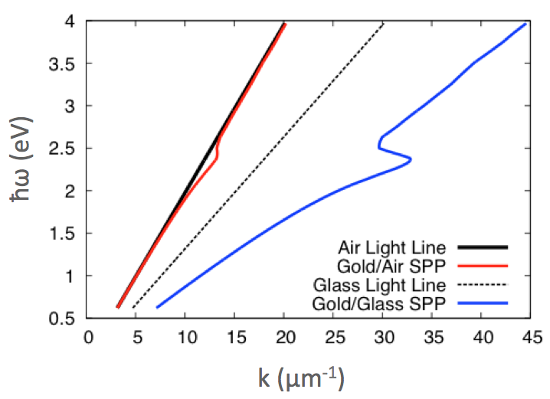

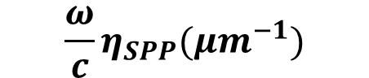
SPP Dispersion
Plasmonic Fingerprints
$$ℏω\left(eV\right)$$
Total energy of photon or electron used to excite SPP
Momentum parallel to surface proportional to this:
$${\frac{ω}{c}η}_{SPP}(μm^{−1})$$

Slide 8
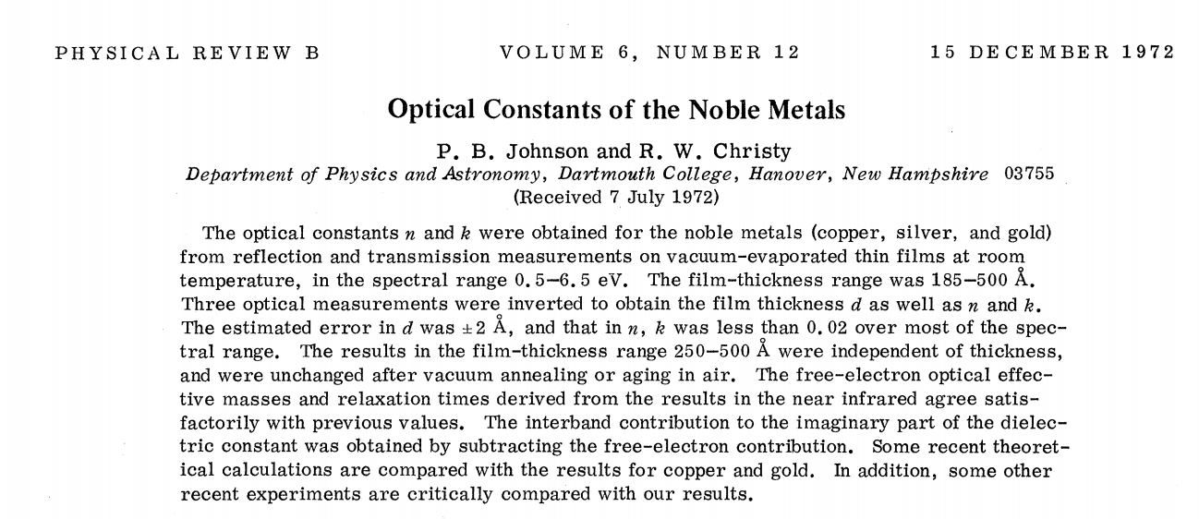
Let’s Calculate our own SPP fingerprints!

Slide 9
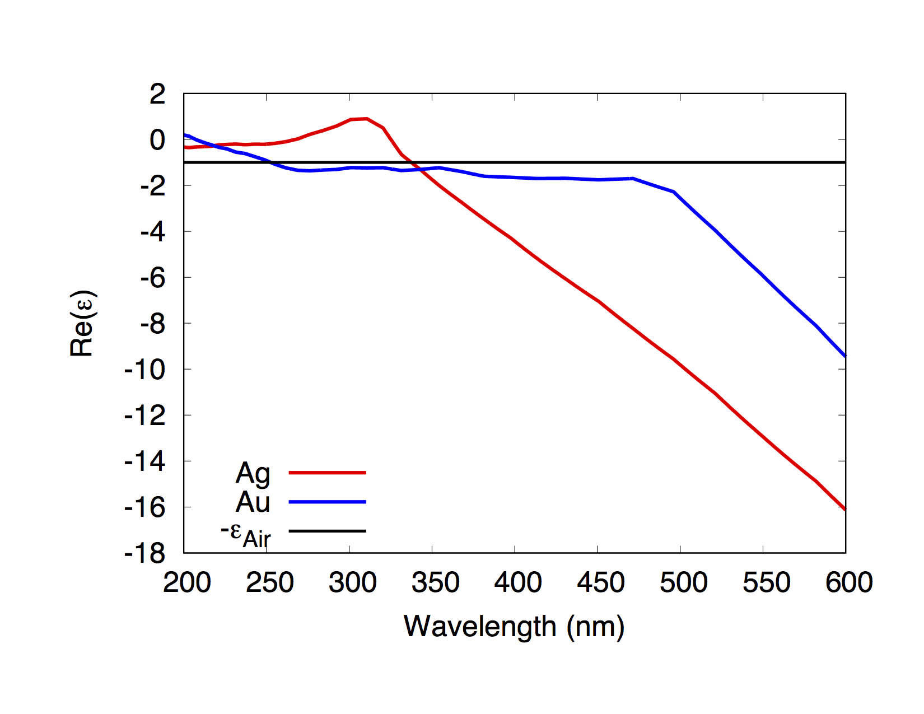
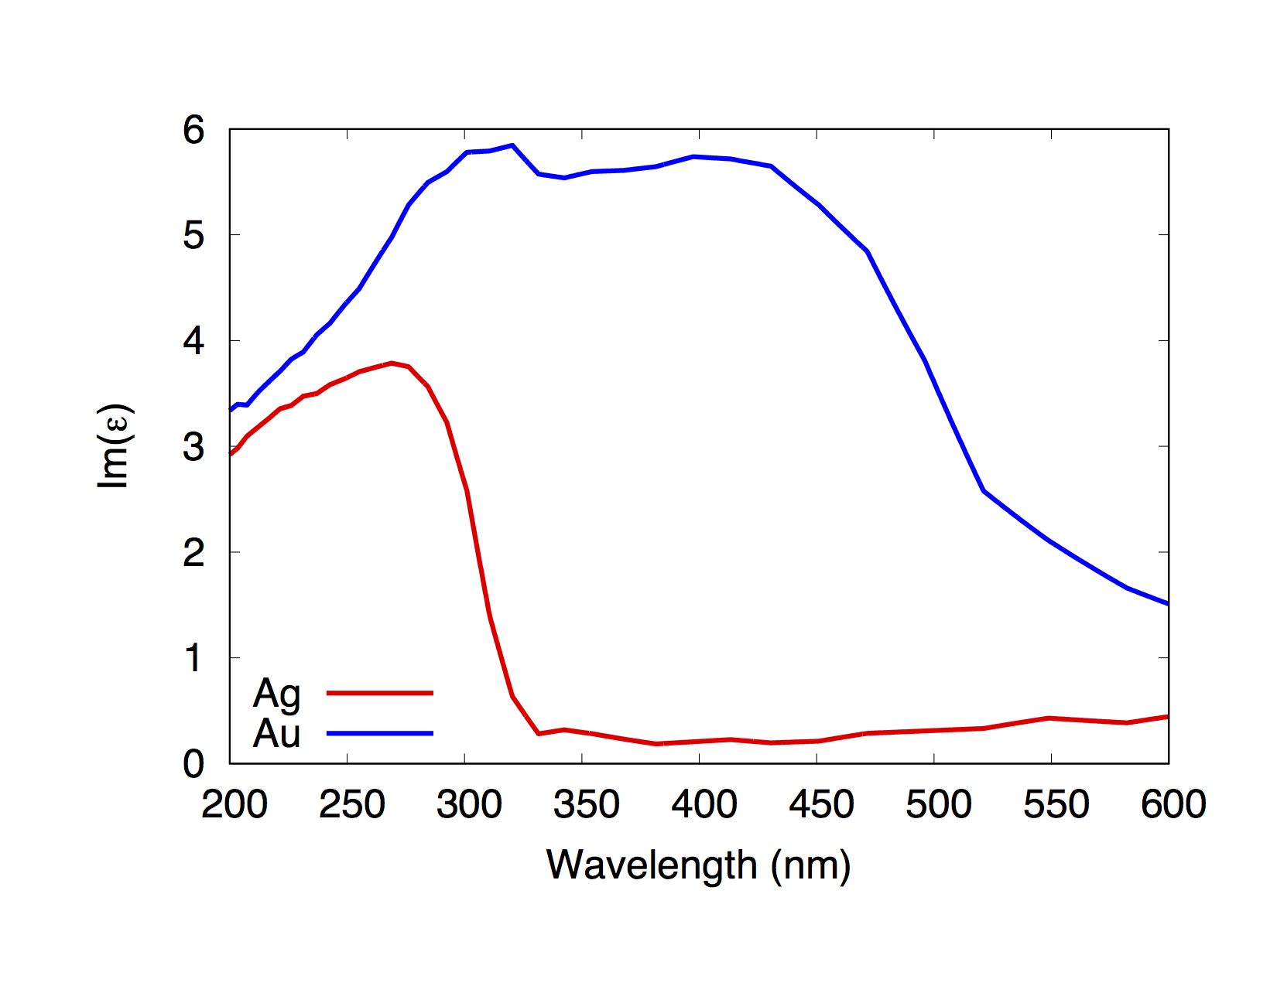
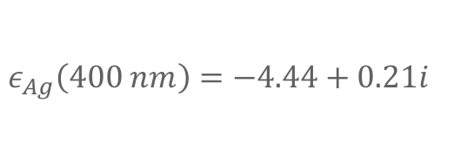
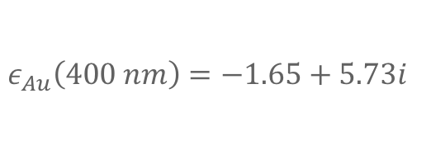
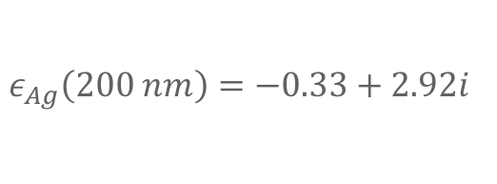
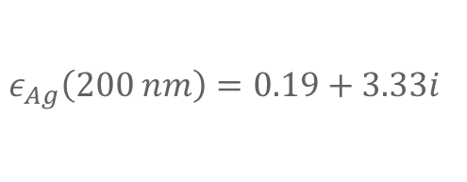
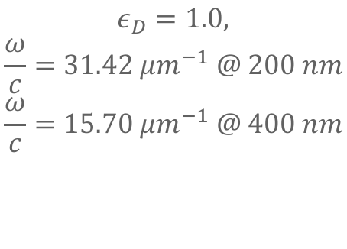
Let’s Calculate our own SPP fingerprints!
$$ε_{Ag}\left(400 nm\right)=−4.44+0.21i$$
$$ε_{Ag}\left(200 nm\right)=−0.33+2.92i$$
$$ε_{Au}\left(400 nm\right)=−1.65+5.73i$$
$$ε_{Ag}\left(200 nm\right)=0.19+3.33i$$
$$ε_{D}=1.0,$$
$$\frac{ω}{c}=31.42 μm^{−1} @ 200 nm$$
$$\frac{ω}{c}=15.70 μm^{−1} @ 400 nm$$

Slide 10
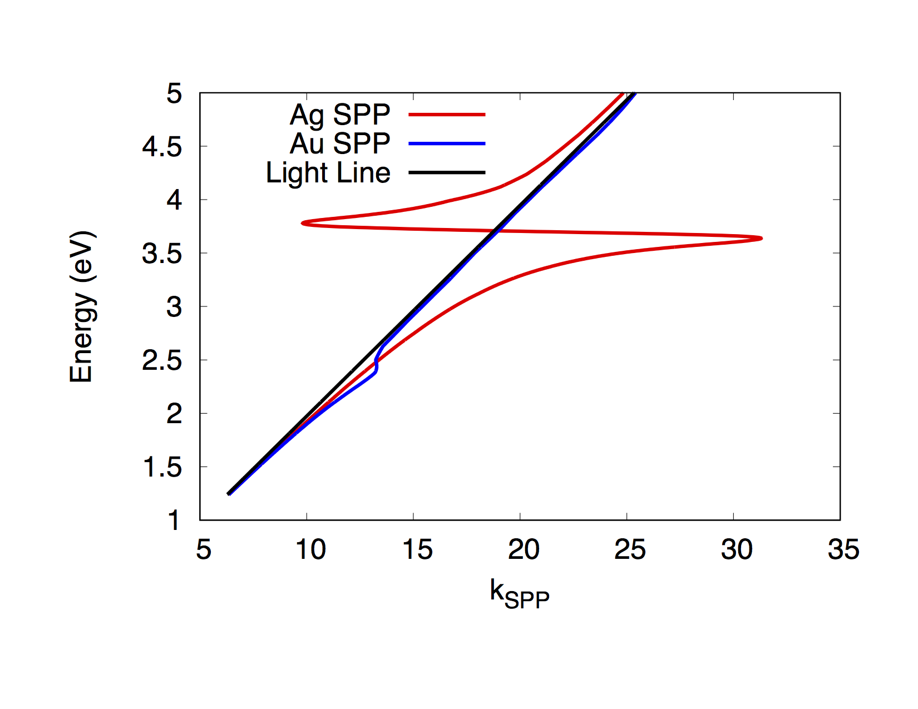
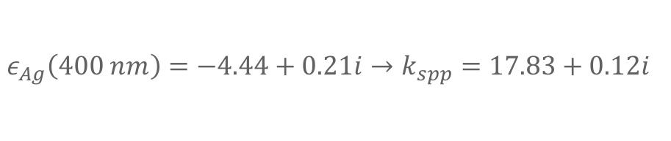
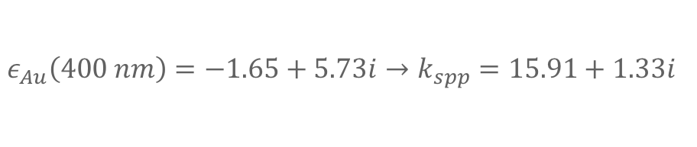
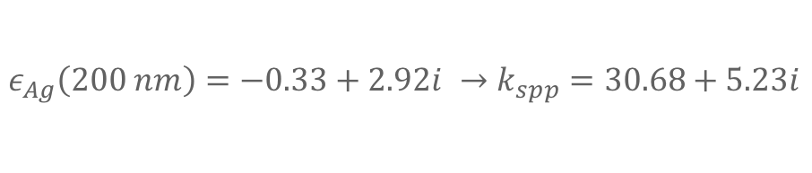
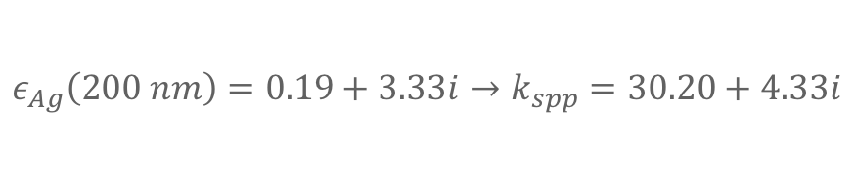
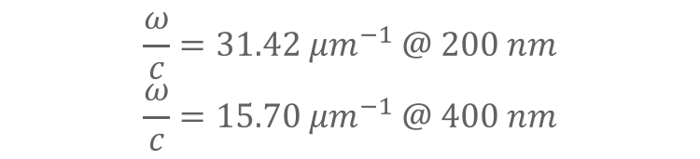
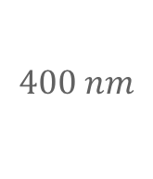
Let’s Calculate our own SPP fingerprints!
$$ε_{Ag}\left(400 nm\right)=−4.44+0.21i→k_{spp}=17.83+0.12i$$
$$ε_{Au}\left(400 nm\right)=−1.65+5.73i→k_{spp}=15.91+1.33i$$
$$ε_{Ag}\left(200 nm\right)=−0.33+2.92i →k_{spp}=30.68+5.23i$$
$$ε_{Ag}\left(200 nm\right)=0.19+3.33i→k_{spp}=30.20+4.33i$$
$$\frac{ω}{c}=31.42 μm^{−1} @ 200 nm$$
$$\frac{ω}{c}=15.70 μm^{−1} @ 400 nm$$
$$400 nm$$
Which are SPPs and which are not?

Slide 11
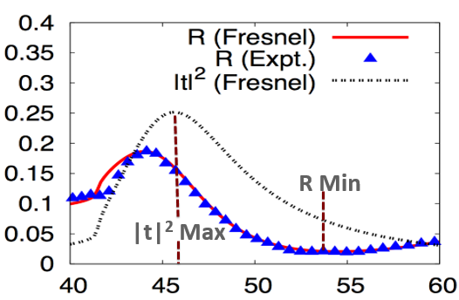
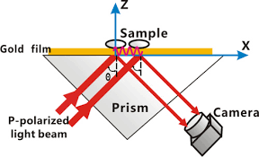
How to excite SPPs?
The key is to match energy & momentum of your excitation source to the energy & momentum of the SPP

Slide 12
The key is to match energy & momentum of your excitation source to the energy & momentum of the SPP
What is momentum of the SPP proportional to?

Slide 13

The key is to match energy & momentum of your excitation source to the energy & momentum of the SPP
What is momentum of the SPP proportional to?
$$Re\left(k_{spp}\right)$$

Slide 14
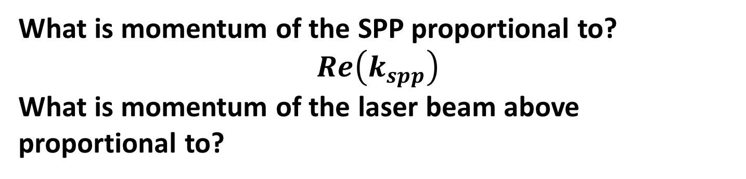
The key is to match energy & momentum of your excitation source to the energy & momentum of the SPP
What is momentum of the SPP proportional to?
$$Re\left(k_{spp}\right)$$
What is momentum of the laser beam above proportional to?

Slide 15
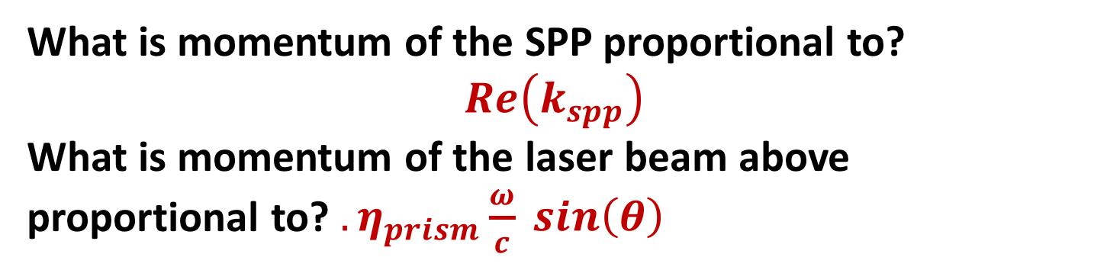
The key is to match energy & momentum of your excitation source to the energy & momentum of the SPP
What is momentum of the SPP proportional to?
$$Re\left(k_{spp}\right)$$
What is momentum of the laser beam above proportional to? ${. η}_{prism}\frac{ω}{c} sin\left(θ\right)$

Slide 16
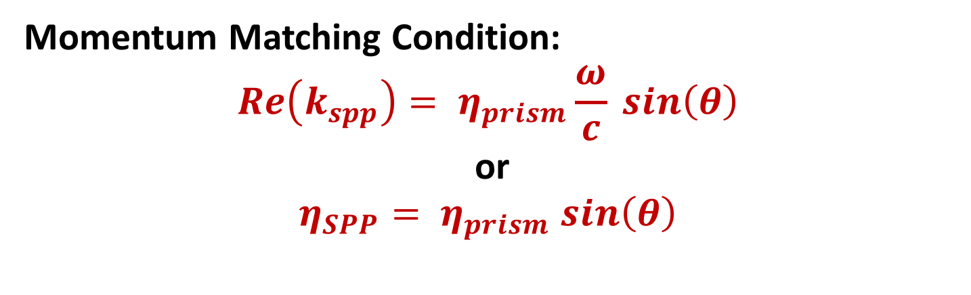
The key is to match energy & momentum of your excitation source to the energy & momentum of the SPP
Momentum Matching Condition:
$$Re\left(k_{spp}\right)= η_{prism}\frac{ω}{c} sin\left(θ\right)$$
or
$$η_{SPP}= η_{prism} sin\left(θ\right)$$

Slide 17
How do you excite SPPs?
Many people have claimed that you excite SPPs precisely at the angle at which reflection from the metal film is minimized. Many people have been wrong!

Slide 18
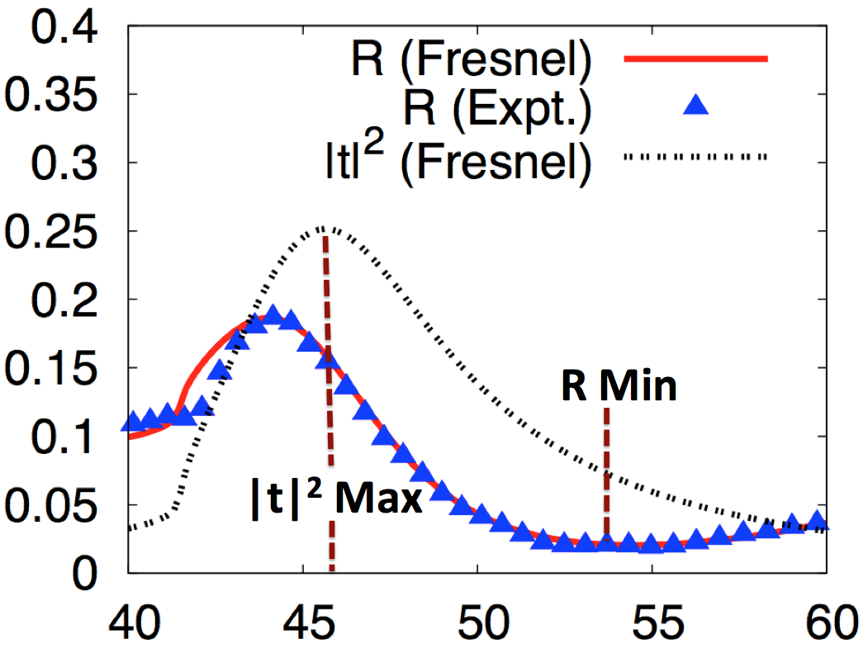
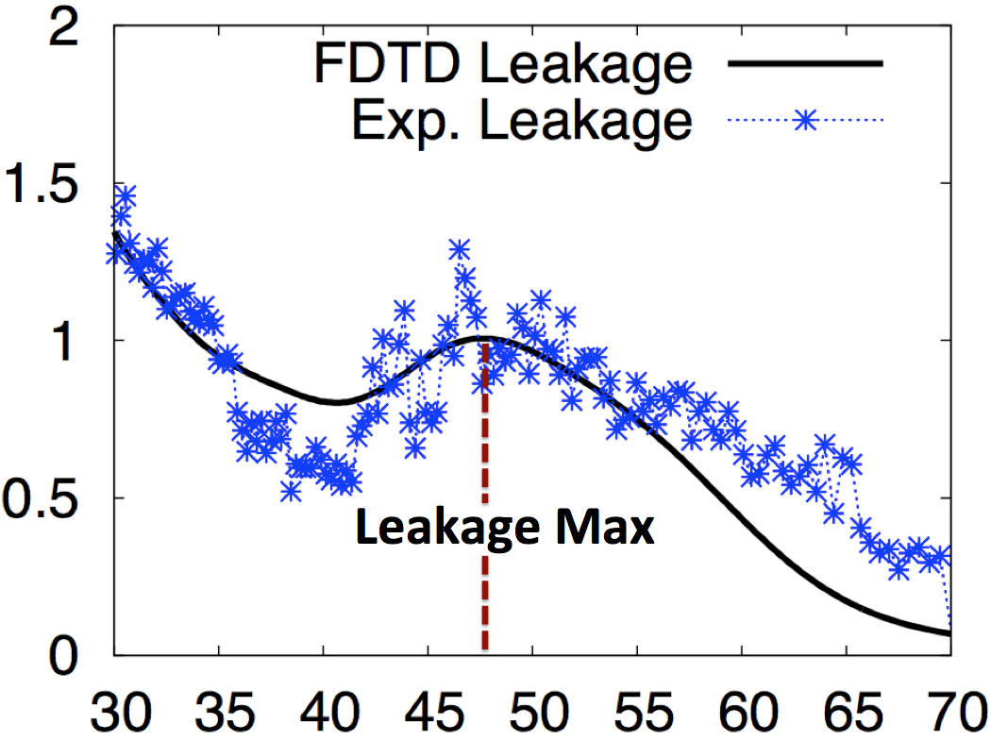
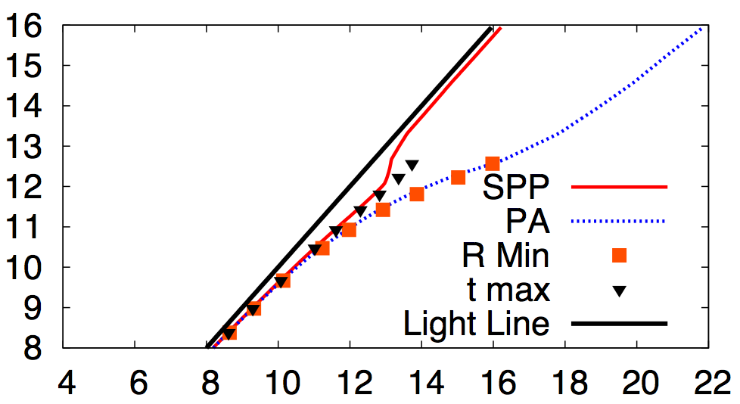
How do you excite SPPs?
a)
Amplitude
Amplitude
θ (deg.)
θ (deg.)
c)
Two finger prints can be found: One follows minimum reflectance angle, one follows maximum transmission amplitude angle
k₀ (μm⁻¹)
514 nm
β (μm⁻¹)
doi:10.1038/srep09929

Slide 19
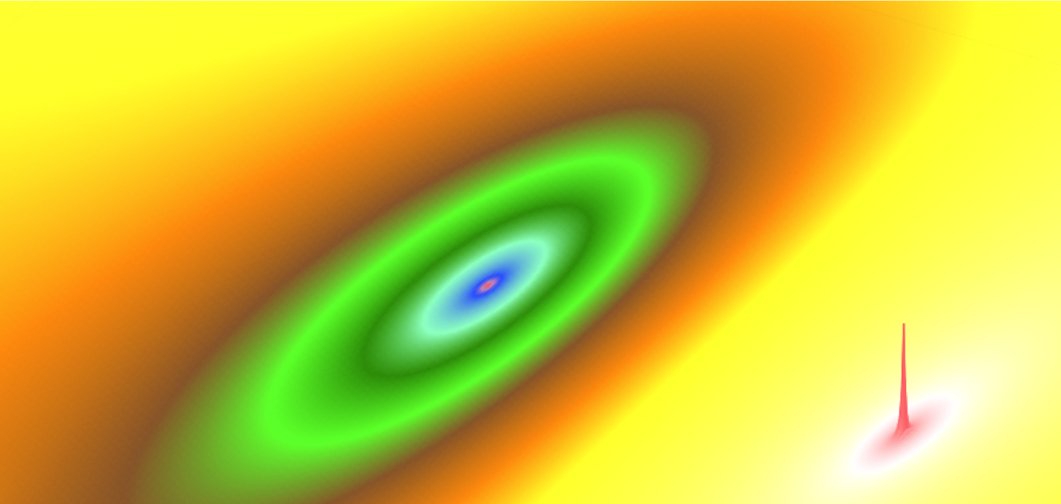
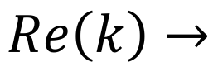

What’s excited at the Kretschmann-Raether minimum? A Perfectly Absorbing Mode!
PA Mode
SPP Mode
$$Im\left(k\right)→$$
$$Re\left(k\right)→$$

Slide 20
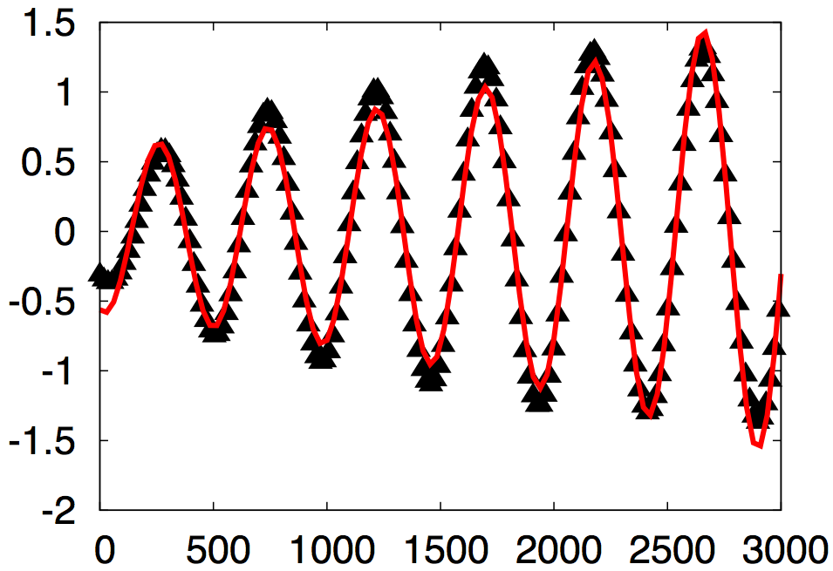
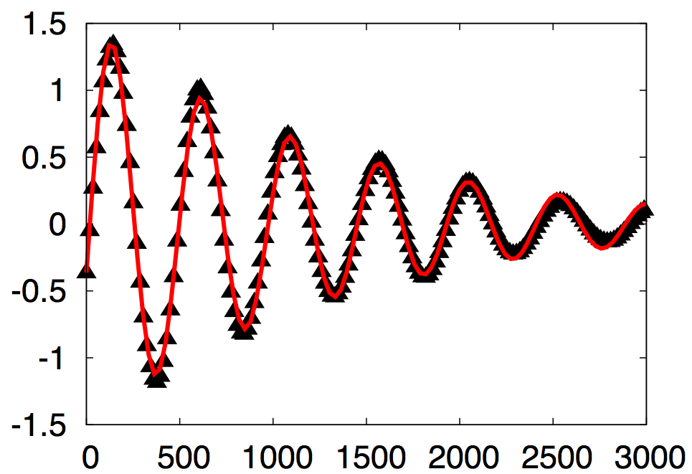
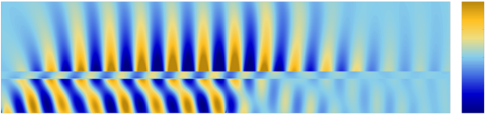
Excitation at angle that gives max in transmission amplitude
Re(E_{x})
Re(E_{x})
β = 13.11
β = 13.14
FDTD
FDTD
Distance (nm)
Distance (nm)
1
0
z
-1
Driven at 44.9°
Propagating
x

Slide 21
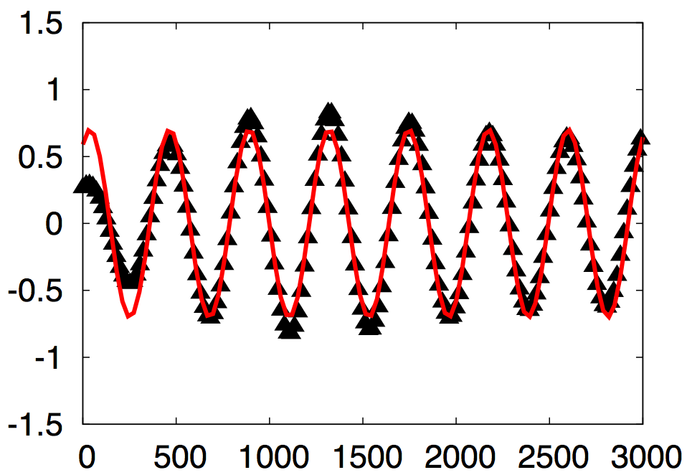
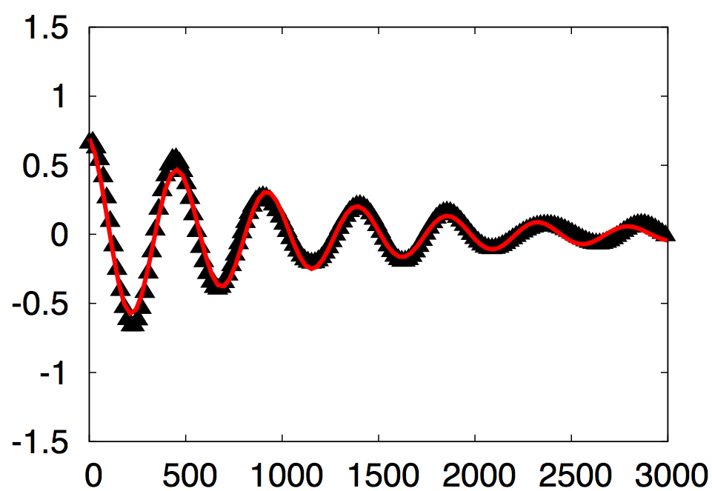
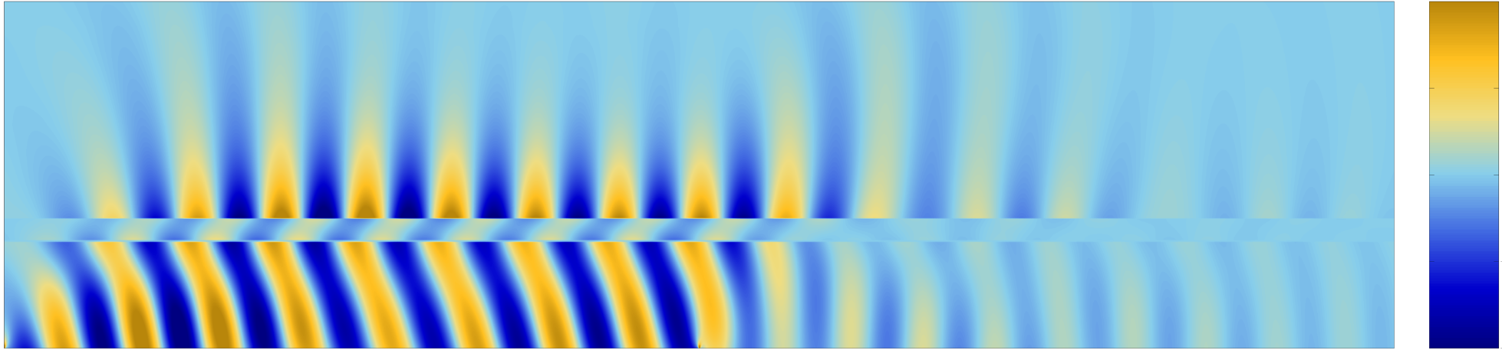
Excitation at angle that gives min in Reflectance
Re(E_{x})
Re(E_{x})
β = 14.76
β = 13.43
FDTD
FDTD
Distance (nm)
Distance (nm)
1
0
z
-1
-1
Driven at 54.2°
Propagating
x

Slide 22
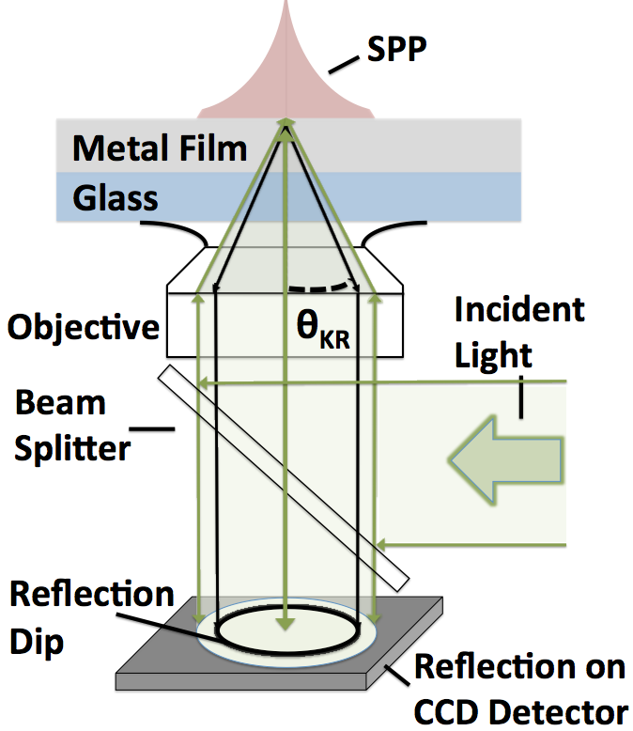
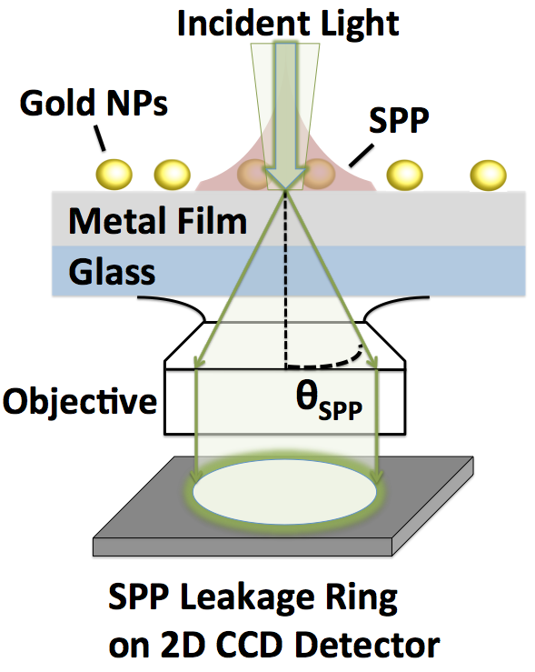
Experimental configurations for measuring the signatures of the SPP mode and the new mode (Perfectly absorbing mode)
a) Kretschmann-Raether Setup
b) Leakage Radiation Setup
z
x

Slide 23
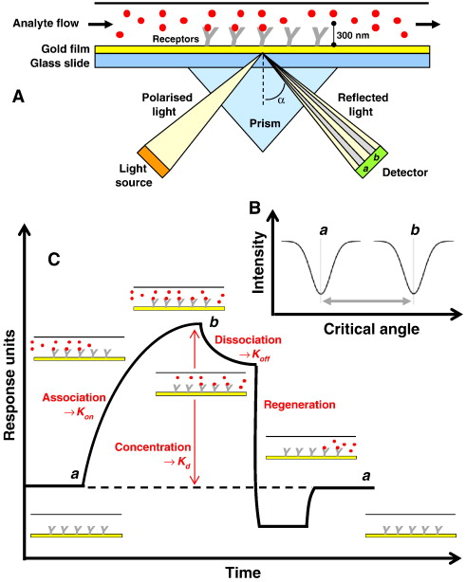
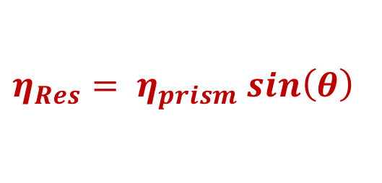
SPR and/or PA Resonance can be used to measure thermodynamic and kinetic properties ligand binding
Observable signal when
$$η_{Res}= η_{prism} sin\left(θ\right)$$
Gibbs Free Energy under standard conditions related to equilibrium constant:

Slide 24
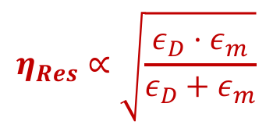
SPR and/or PA Resonance can be used to measure thermodynamic and kinetic properties ligand binding
Observable signal when
$$η_{Res}= η_{prism} sin\left(θ\right)$$
$$η_{Res}∝\sqrt{\frac{ε_{D}⋅ε_{m}}{ε_{D}+ε_{m}}}$$
Gibbs Free Energy under standard conditions related to equilibrium constant:

Slide 25
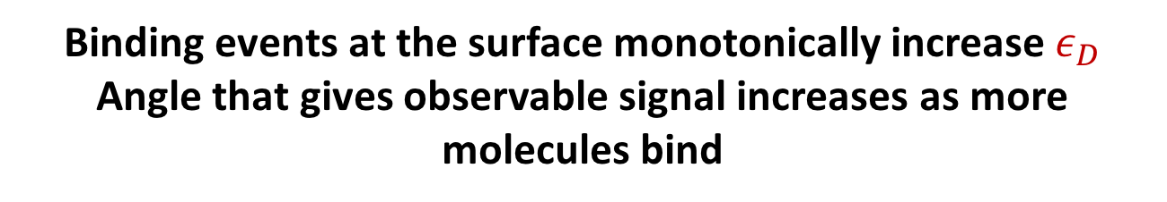
Binding events at the surface monotonically increase $ε_{D}$
Angle that gives observable signal increases as more molecules bind
Observable signal when
$$η_{Res}= η_{prism} sin\left(θ\right)$$
$$η_{Res}∝\sqrt{\frac{ε_{D}⋅ε_{m}}{ε_{D}+ε_{m}}}$$
Gibbs Free Energy under standard conditions related to equilibrium constant:

Slide 26
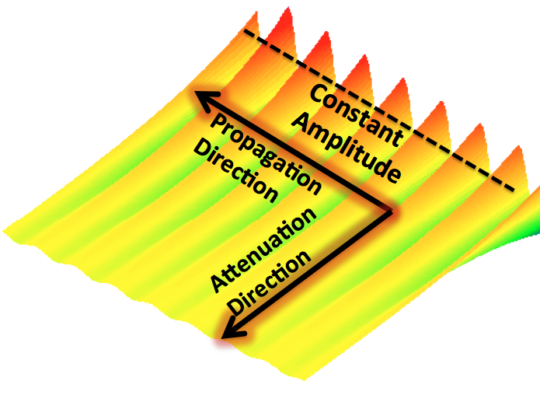
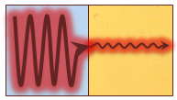
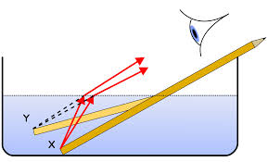
Squeezing Light down to 1-dimension
Scientific Achievement
Identified a new type of plasmon called an ISPP that results from refraction of SPPs
Significance and Impact
ISPPs provide new ways control optical energy at the nanoscale
Profile of ISPP wave
Foley et al. ACS Photonics 1 739 (2014)
Light guided along one metal (silver) encounters a different metal (gold), creating an ISPP

Slide 27
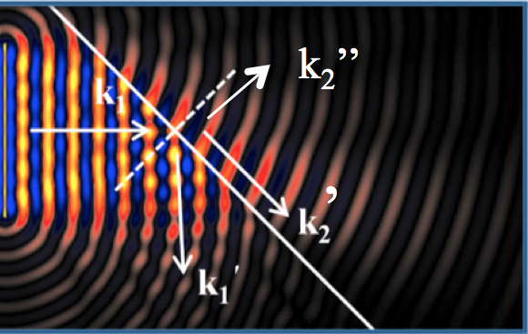






Light confined to One Dimension?
Real and Imaginary components of SPP wavevector have different refraction angles
$$n_{D1}$$
$$n_{D2}$$
$${n_{m1}\left(ω\right)+ik_{m1}\left(ω\right)}^{ }$$
$${n_{m2}\left(ω\right)+ik_{m2}\left(ω\right)}^{ }$$
Ag
Al
$${{\tilde{η}}_{1}}_{ }\left(ω\right)$$
$${{\tilde{η}}_{2}}_{ }\left(ω\right)$$
Foley et al. ACS Photonics, 2014, 1, 739

Slide 28



Light confined to One Dimension?
Inhomogeneous waves: real and imaginary wavevector components point in different directions
$\hat{k′}=\frac{ω}{c} η\hat{a}$
$\hat{k′′}=\frac{ω}{c} κ\hat{b}$

Slide 29



Generalization of Snell’s law for SPPs?
Creating inhomogeneous SPPs follows from complex Snell’s Law
k₂’’
’
Foley et al., ACS Photonics, 1, 739 (2014)

Slide 30
Generalization of Snell’s law for SPPs?
Properties of the ISPP depend on properties of BOTH surfaces
$$N_{2}^{2}≈η_{2}^{2}+κ_{1}\sin\left(θ_{1}\right)−2η_{1}\sin\left(θ_{1}\right)…$$
k₂’’
’
Foley et al., ACS Photonics, 1, 739 (2014)

